Slide 1
Anadach Consulting in collaboration with The Nigerian Society of Engineers present Tuberculosis in the Workplace: What should Engineers know?
Advocacy Webinar on Tuberculosis
25th February 2021

Slide 2
USAID/NIGERIA TUBERCULOSIS LOCAL ORGANIZATION NETWORK (TB-LON 3) PROJECT
Implemented by Anadach Consulting in partnership with the
Institute of Human Virology Nigeria (IHVN)

Slide 3
Introduction
Why Tuberculosis (TB)?
1 of top 10 causes of death worldwide & leading cause of death from a single infectious agent
Although curable and preventable, accounted for an estimated 1.4 million deaths globally in 2019
Nigeria has an estimated 440,000 people in Nigeria infected with TB each year
Nigeria is one of the eight highest TB-burden countries in the world
Has highest TB burden in Africa

Slide 4
Introduction
Challenge: TB response in Nigeria is low TB case detection; 3 out of 4 cases are undetected
TB is most easily spread in poorly ventilated, crowded spaces with close contact amongst people
Critical to rapidly find and treat undiagnosed people infected with TB.
SDG Target 3.3: proposes to end the preventable death of newborns and children under 5 and to end epidemics such as AIDS, tuberculosis, malaria and water-borne diseases

Slide 5
Basically, How Does TB Spread?
TB bacteria usually spreads through the air from one person to another.
The TB bacteria are discharged into any air space when someone with TB disease of the lungs or throat coughs, speaks, or sings.
It is very possible for TB bacteria droplets to remain in a poorly ventilated air space for several hours
There is high likelihood that people within that environment could breathe in these bacteria and become infected.

Slide 6
Types of TB
Two TB conditions exist:
Latent TB infection:
TB bacteria remain inactive in the body without causing disease
People with latent TB infection have no symptoms and can’t spread the bacteria to others
A strong immune system keeps TB in control
They may, however, develop TB disease if they do not receive treatment

Slide 7
Types of TB
Active TB disease:
When TB bacteria are active in the body, this is called active TB disease
TB bacteria become active if the immune system is unable to prevent them from growing
People with TB disease develop symptoms and are able to spread the bacteria
Pulmonary TB is the commonest site and most infectious form of TB

Slide 8
Signs and Symptoms of TB
Symptoms of TB depend on the part of the body affected by the disease
Pulmonary TB (TB in the lungs) may cause:
Cough that lasts 2 weeks or longer or current cough among people living with HIV
Chest pain
Coughing up blood-stained sputum

Slide 9
Signs and Symptoms of TB
Extra-pulmonary TB:
Depends on the organ affected
Enlarged lymph nodes, swelling or deformity of the spine, slow onset meningitis, etc

Slide 10
Other Symptoms
Other symptoms of TB are:
Fatigue or weakness
Weight loss
Loss of appetite
Chills
Fever
Night sweats

Slide 11
Risk Factors
Factors that increase vulnerability to TB:
Weak immune system due to HIV, malnutrition, diabetes, smoking
Poverty
Crowded and poorly ventilated settings e.g urban slums, IDP camps, prisons
Stigma
Gender – Although men are most likely to develop active TB, women and children are less likely to receive diagnostic & treatment services in some settings

Slide 12
Risk Factors
Occupations most at risk:
Migrant farm workers – due to poor living conditions, inadequate ventilated houses
Labourers in mining, construction and manufacturing – due to high silica exposure
Agriculture sector
Manufacturing/construction industries and
Oil and gas industry workers
Many live in close quarters (on camps or offshore platforms), which facilitate spread of TB

Slide 13
TB and the Workplace
Workplace presents a unique avenue to address TB as it provides access to a large number of workers, allows opportunity for regular sessions at work
Onsite and in-house clinics and communication systems could also be fully explored for increased TB awareness, screening and detection.
Importance of TB awareness in the workplace include:
Prevent negative impact on private businesses such as increase in absenteeism, reduction of productivity, loss of skills and experience, disruption of workflow, increase in direct cost (treatment and care) and increase in indirect cost (replacement and retraining of workers)

Slide 14
Private Sector Participation – Why?
Track record of supporting disease control/eradication efforts, such as in the fight against polio and malaria; achieving significant health gains
Leveraging on the recorded gains; private sector is well-positioned to expand demand for and access to TB services as well as improve financing of TB services in Nigeria.
Increased organized private sector awareness and involvement in TB control, staff screening and detection by occupational physicians can be encouraged
Private sector insurance plans or medical retainership/financing can incorporate coverage of TB services.

Slide 15
To the Rescue – Organized Private Sector
Anadach Group is working on this project in partnership with the Institute of Human Virology Nigeria (IHVN) supported by the USAID/Nigeria Tuberculosis Local Organization Network (TB-LON) in Lagos, Ogun, Oyo & Osun States
Two main project objectives:
Mobilize the organized private sector to support TB early detection, prevention and treatment
Build capacity for staff screening and detection by occupational physicians.
Project is funded by the United States Agency for International Development (USAID)

Slide 16
Are Your Personnel At Risk?
People with TB disease are most likely to spread it to people they spend time with every day. This includes family members, friends, and co-workers
As Engineers our business and operations office system is arranged in such a way that people have some common regular meeting points and (depending on the volume of personnel) these meeting points are potential hot spots for transmission.
It is important to note that the risk of TB transmission becomes more likely when the space becomes crowded and poorly ventilated.

Slide 17
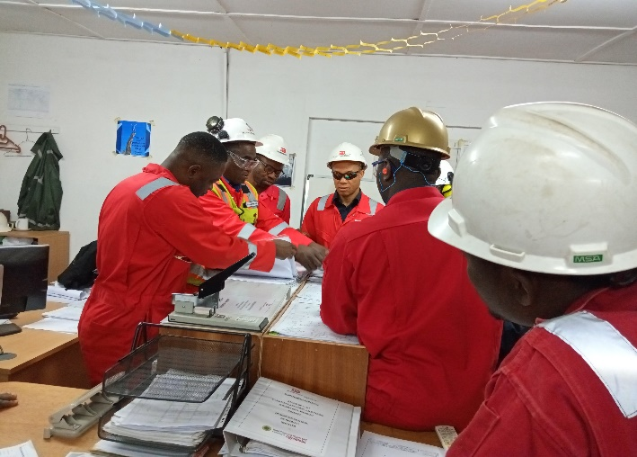
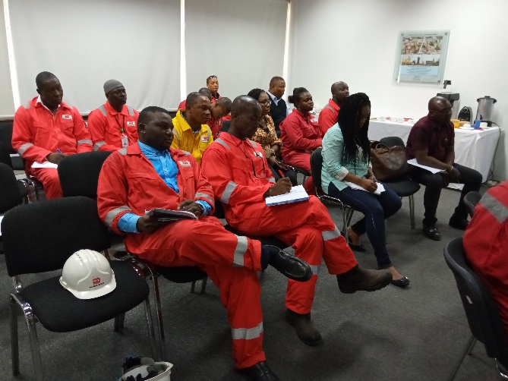
Where Are the Likely Areas For Transmission?
Fabrication Operation Floor
The Engineering Offices
The General Meeting Rooms
Fabrication operation environment with crowded operators due to on going construction activities. This is a likely area for TB Transmission
Engineering offices with poorly spaced layout, overcrowded and poorly ventilated. This is a likely area for TB Transmission
Meeting rooms with no ventilation and poor air conditioning system can also aid the spread if a TB patient is present.

Slide 18
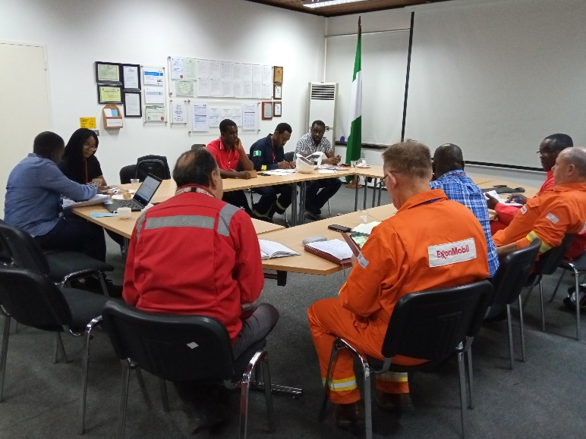
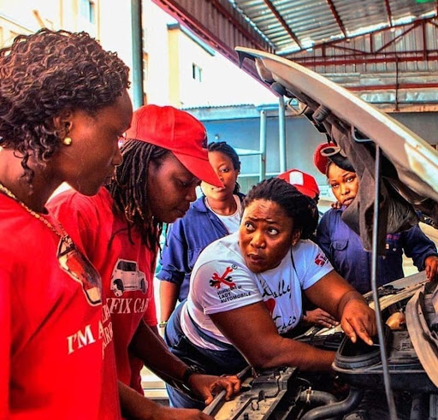
Where Are the Likely Areas For Transmission?
The Conference Rooms
The Auto Repair Workshop
Even conference rooms having a well functional air conditioning system with both doors and windows closed (due to air circulation) will increase the likelihood of TB transmission with a TB patient present.
On-the-Job training sessions with close conversion distance even in an open environment are also areas of likely TB transmission if an infected patient is present.

Slide 19
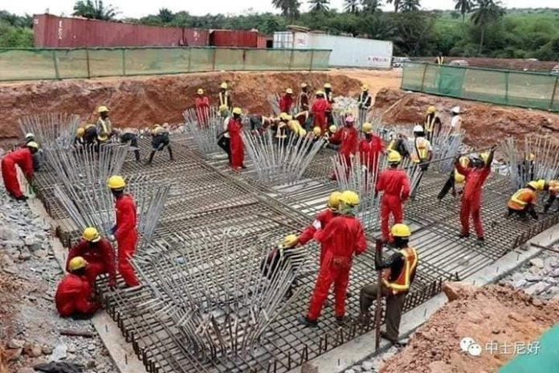
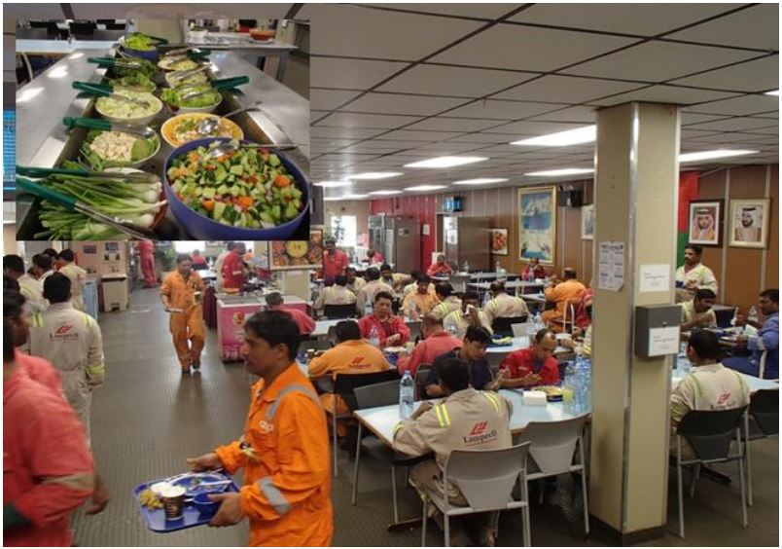
Where Are the Likely Areas For Transmission?
The Construction Sites
The Cafeteria
Over crowded Construction site with close working distance even in an open area can be a dangerous ground for TB transmission.
Also in a crowded Cafeteria during a general lunch break with lots of close conversations going on while eating, there is high likelihood of TB transmission.

Slide 20
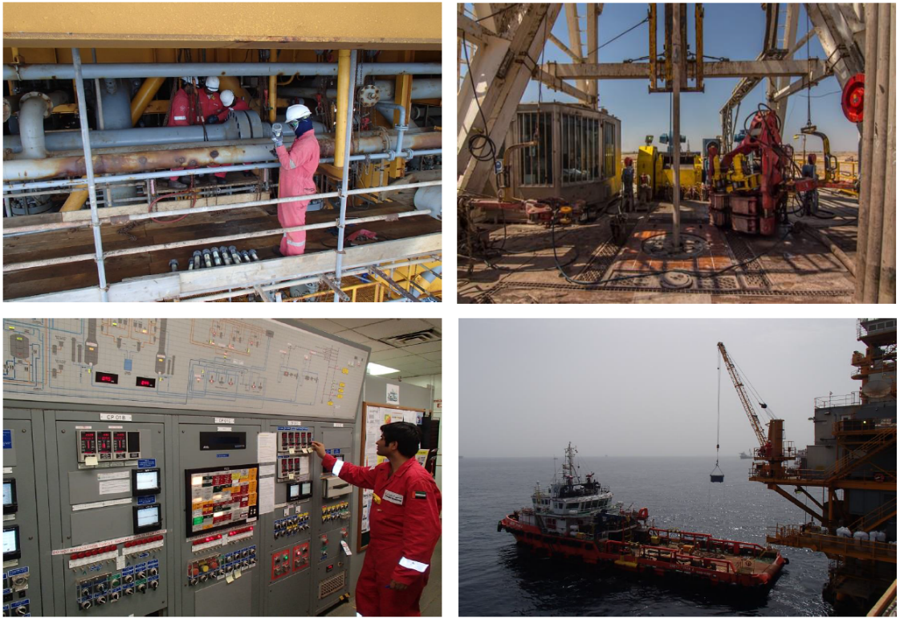
Where Are the Likely Areas For Transmission?
Offshore Platforms
Oil & Gas workers offshore mostly work in confined spaces and in the event of a latent TB case becoming active while offshore, transmission is inevitable.
In spite of medical screening carried out on workers before offshore deployment, cases of TB transmission are reduced but not impossible.
TB cases among offshore installation workers have been detected in recent past which have led to deeper testing for TB at the latent stage.

Slide 21
TB is NOT Transmitted by
Shaking Someone’s Hand
Sharing Food or Drink
Touching Bed Linens or Toilet Seats
TB cannot be Contracted from Clothes, Drinking glass, Eating utensils or Other surfaces
NB: When a person breathes in TB bacteria, the bacteria can settle in the lungs and begin to grow. Only TB disease in the lungs or throat can be transmittable.

Slide 22
What Can Private Businesses Do?
Improve knowledge on TB and increase identification of TB patients
Reduce the burden of TB in the workplace
Improve financing of TB services in Nigeria
Anadach Group is available to provide the knowledge on TB through advocacy to all private sector stakeholders and sensitization/capacity building for staff screening and detection in interested organizations in Lagos, Ogun, Oyo and Osun States

Slide 23
Conclusion
Increase in the detection of TB in Nigeria is possible
Consequential positive implication for testing and treatment
Achieve a country with low burden of the disease in the workplace
Improve financing for TB services and coverage in Nigeria
Increased awareness of risk factors aiding spread of TB in workplaces as well as preventive measures for TB are very important for engineers to note.

Slide 24
For further information
Website: www.anadach.com
Email: bogbodu@Anadach.com
Phone: 08107611982, 08023061091
Team Lead- Olubunmi Ogbodu, MPH, PhD

