Slide 1
Dr. Amit N. Thakker
Chairman, Africa Health Business
New Rehema House
Rhaphta Road, Westlands
Nairobi-Kenya
www.ahb.co.ke
Africa Health Business
Moderator
Interactive discussion including questions from the audience
+254 704 835 926
info@ahb.co.ke
@AfricaHealthBiz

Slide 2
COVID-19 Pandemic and other health issues: What can be done?
1
Increase private sector engagement
2
Digital health regulation : supply chain
3
Quantity and quality of HRH

Slide 3
The economy: What can be done?
Increased public sector spending on health
Stronger private sector partnerships
More money more health, more health more money
More money more health
Ministry of finance
Ministry of ICT
Ministry of health
More health for more money

Slide 4
COVID-19 in Africa: Breaking the vicious cycle between the COVID-19 pandemic and other health issues, and the negative impact on the economy
NOTES

Slide 5
Breaking the vicious cycle between the COVID-19 pandemic and other health issues
The COVID-19 pandemic has had a major impact on the capacity of health systems to continue the delivery of essential health services.
While health systems around the world are being challenged by increasing demand for care of COVID-19 patients, it is critical to maintain preventive and curative services, especially for the most vulnerable populations, such as children, older persons, people living with chronic conditions, minorities and people living with disabilities.
Source: WHO
Policy makers will need to invest time and resources towards a more transparent, accountable, and strategic plan for their private health sectors. The challenges in responding to COVID-19 present an important opportunity to strengthen accountability and the relationship between public authorities and private providers.
This is also a moment for governments to rekindle discussions about Universal Health Coverage. Better governance and effective oversight of the private sector are important for developing countries to strengthen their health systems while tackling the COVID-19 pandemic.
Governments should build their own capacity in UHC to ensure essential health for all.
Source: World Bank

Slide 6
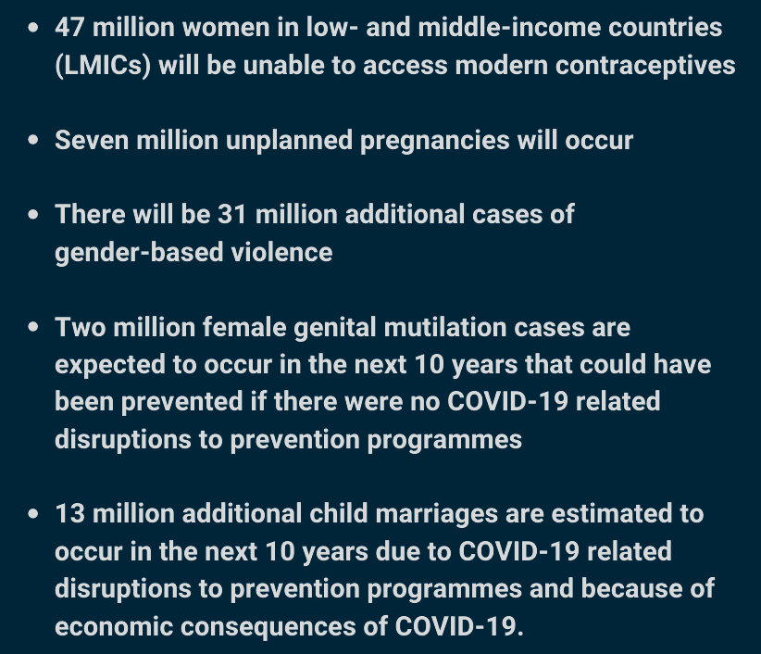
Notes on health concerns
The United Nations Population Fund (UNFPA) estimates that the impact of COVID-19 on Sub-saharan Africa will be devastating. They project:
In Chad, Ethiopia, Nigeria and South Sudan, disruptions in measle vaccination programmes have left over 20 million children unprotected.
Gavi, the vaccine alliance, has postponed 14 vaccination programs against polio, measles, cholera, human papillomavirus, yellow fever and meningitis, which would have covered over 13 million people.
The WHO has also made the decision to redirect resources meant for the vaccination of 12 million children in sub-Saharan Africa against polio to COVID-19.
The WHO further warned that deaths caused by malaria could increase to more than 700,000 in sub-Saharan Africa this year if prevention and treatment programmes are disrupted by COVID.
The Bill & Melinda Gates Foundation has pledged to shift almost its entire organisation to focus on COVID-19, posing a risk to their programmes on HIV, malaria and polio eradication
Source: Health Action International

Slide 7
Notes on health concerns
A new analysis by WHO and partners suggests that in a worst case scenario if malaria prevention and treatment services were severely disrupted as a result of COVID-19, the number of malaria deaths in 2020 in sub-Saharan Africa could rise to double the number in 2018.
Another essential health service is immunization. The response to COVID-19 has already disrupted vaccination efforts on the continent. Despite considerable progress on immunization, one in four African children remain under-immunized. Measles vaccination campaigns in Chad, Ethiopia, Nigeria and South Sudan have already been suspended because of COVID-19, leaving approximately 21 million children who would have otherwise been vaccinated unprotected. In response to the introduction of physical distancing measures, WHO has published guidelines on immunization in the context of COVID-19.
According to a WHO survey, Prevention and treatment services for noncommunicable diseases (NCDs) have been severely disrupted since the COVID-19 pandemic began. In the majority (94%) of countries responding, ministry of health staff working in the area of NCDs were partially or fully reassigned to support COVID-19. Noncommunicable diseases kill 41 million people each year, equivalent to 71% of all deaths globally. Each year, 15 million people die from an NCD between the ages of 30 and 69 years; more than 85% of these "premature" deaths occur in low- and middle-income countries.
Source: WHO,, COVID-19 significantly impacts health services for noncommunicable diseases

Slide 8
COVID-19 and the negative impact on the economy
It is estimated that that COVID-19 will drag African economies into a fall of about 1.4% in GDP, with smaller economies facing contraction of up to 7.8%.¹
COVID-19 has a negative impact on direct trade links with other partner continents such as Asia, Europe and North America, which also affects tourism; the decline in remittances from African Diaspora and domestic financial market tightening.
There has also been an increase in morbidity and mortality leading to a disruption of economic activities leading to a decrease in domestic demand in tax revenue coupled with an increase in public expenditure to safeguard human health and support economic activities.
Source:
1 Assessing the Impact of COVID-19 on Africa’s Economic Development
2 Impact of the Coronavirus (COVID-19) on the African Economy
To break this cycle between the pandemic and the negative impact on the economy, there should be;²
An immediate coordination of health specific responses and revamping expenditure on health systems by African governments This should be augmented by debt moratoriums and increased inflows of other foreign assistance to ensure the availability of resources to fight COVID-19, especially in LDCs.
The implementation of the African Continental Free Trade Area (AfCFTA) will play a crucial role in diversifying African economies and helping to shield them from global commodity price volatilities that have continued to dictate the direction of the continents trade and economic progress.

