Slide 1
Webinar 1
Dynamic Private Health Sector Enterprise Governance
November 19, 2020

Slide 2
Webinar 1 Agenda
Private Sector Organizations
Private Sector Board Challenges
Board Performance Goals
Board Best Practices
Board Education Resources

Slide 3
1
Private Sector Organizations
Healthcare Facilities e.g. hospitals, clinics, surgical centers
Health Insurance Companies
Pharmaceutical Companies, Distributors and Retail Pharmacies
Health & Computer Technology Companies

Slide 4
2
Private Sector Board Challenges
Factors that constrain the vitality and performance of private health sector enterprises and ROI for investors.

Slide 5
Private Sector Board Challenges
External:
Internal:
Market Uncertainties
Demanding Customers
Competitor Moves
Attract Wise Board Members
Establish Board Role Clarity
Dysfunctional Board-CEO Partnership
Regulations
Financing
Contract Law
Stimulate Demand
Support Credit
Customer Loyalty
Innovative Features
Market Cultivation
Customer Support

Slide 6
Private Sector Board Challenges
External:
Internal:
Market Uncertainties
Demanding Customers
Competitor Moves
Attract Wise Board Members
Establish Board Role Clarity
Dysfunctional Board-CEO Partnership
Job Description
Development
Annual Assessment
Competency Map
Compensation
Onboarding
Authority Matrix
Mutual Expectations
Transparency & Trust

Slide 7
3
Private Enterprise Board Performance Goals
Expectations to
Optimize Board Value

Slide 8
Private Enterprise Board Performance Goals
Establish and Oversee Sensible Strategic Growth and Financial Plan including external financing e.g. Banks, Private Equity etc.
Empower the Mobilization of Resources to Executive the Plans
Enable Realistic Execution of the Business Strategy
Talent
Working Capital
Infrastructure
Product-Service Plans
Market Growth Plans
Financial Plans
Input Sales Insights
Innovate Product-Service Introduce Markets

Slide 9
4
Board Best Practices
Empower Board Performance

Slide 10
SMARTER Governance Practices
Steward Scarce Resources
Expect Accountable Results
04
Open & Transparent Decision Making
03
05
Champion the Mission.
Resources
Engage Diverse Stakeholders
Accountable
02
Transparent
06
Engagement
Mission
Continuously Review and Enhance Board Work
Establish Strategic Direction.
01
Board
Structures
07
Strategic
Review

Slide 11
5
Board Education Resources
Some Examples
Leaders Who Govern 400 page Text
Five Guides on Best Practices
Five Handbooks on Best Practices
Governance and Health
Key Practices of Good Governance
Infrastructure for Good Governance
Good Governance in Medicines
Public Domain Materials developed by ANADACH Advisory Board Member James Rice

Slide 12
Strategic Thinking for Governance Enhancement and Board Development
As the Boards of private sector enterprises prepare for their work within a challenging and changing health sector, new ways to support each board member’s orientation and development should be planned for each year.
Most boards elect to develop and be guided by a multi-media education program with these key components:
An annual “Board Self-Assessment” by the board of how well they believe the board work is being accomplished;
A periodically updated “New Board Member Orientation Program”;
An annual “Board Education Calendar” of events, speakers and learning experiences (for example Briefs from CEO, materials from hospital associations, and speakers on hot topics by hospital executives, medical staff or out-of-town experts; and
Customized reading materials on topics of particular interest to each board member.

Slide 13
Governance Educational Framework
CEO Briefings
Periodic memos prepared by C-Suite Team and routed through CEO to Board on business challenges, market demand trends, growth opportunities, and policy developments in the market and nation.
Custom Individual Programming
Speakers on Hot Topics
Annually plan for at least two board meetings with Speakers for 15-20 minutes from Medical or Nursing Staff, Executive Team or other health enterprises on topics such as shown on next slide.
Provide custom set of materials for each member based on their identification of topics of interest from next slide. Also leveraged use of ANADACH materials.
Annual
Board Education Plan
Small groups of Board members attend chamber of commerce or association educational programs and report back to full Board on insights and materials.
Association Programs
Spring
Community Education Symposium
Enterprise can host afternoon events with 2-3 speakers on priority topics related to business development and Strategic Plans with invited partner, community leaders and media from the region, ending in light reception with refreshments. Venue outside the enterprise
Staff Support

Slide 14
We will be sending meeting attendees the opportunity to select the the 2-3 topics you would most be interested in from this list:
Topics for Board Education through end of the year:
Trends in Capital Financing: Debt, Investors, Mergers & Acquisitions
Payment system reforms and methods, especially “Pay for Performance” or “Value for Money Contracting” for physicians and for hospitals
Trends in operational cost reductions
Patient centered care and excellent patient experiences
Trends in marketing and business development
Provider burnout in hospitals
Balancing mental health and physical health programming
Maximizing relationships with primary care physicians
Building and governing community health partnerships
Trends in governance best practices
Health Information Technologies and Electronic Medical Records
Hospital Physician Integration and Alignment
Physician leadership development academies and programs
Regulatory oversight and compliance challenges for board members
Succession planning for boards and CEOs
Enhancing medical staff relationships
Safety and Quality
Health Challenges in rural health
Clinical integration and successful clinical service lines
Others you can define here?
To help shape your educational programming within Boards, each board member is being invited to select 2-3 topics from this list (or add more valued topics) that they would want to become more knowledgeable about over the next 12 months.
ANADACH can assemble materials for each member to use in the coming year

Slide 15
https://www.msh.org/sites/default/files/2015-10_msh_leaders_who_govern.pdf

Slide 16
https://www.msh.org/resources/governance-guides-and-handbooks

Slide 17
https://www.globalhealthlearning.org/course/governance-and-health-101

Slide 18
https://www.globalhealthlearning.org/course/key-practices-good-governance

Slide 19
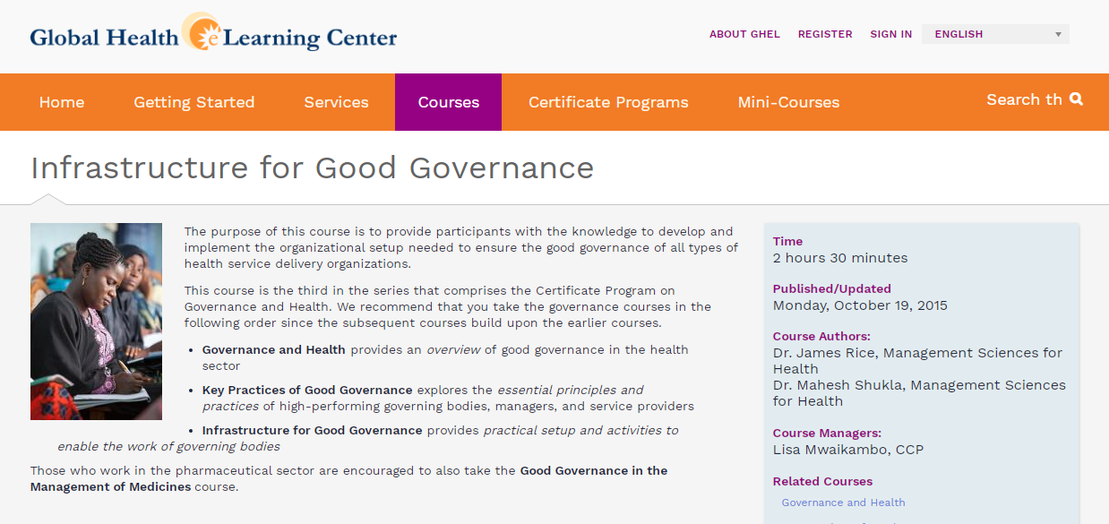
https://www.globalhealthlearning.org/course/infrastructure-good-governance

Slide 20
https://www.globalhealthlearning.org/course/good-governance-management-medicines

